Slide 1
Reliable v Academic Sources
Week 3
Lecturer's Version

Slide 2
Learning Outcomes
To understand the difference between a reliable source and an academic source.
To be able to evaluate a source.
To be able to use the digital library and Google Scholar
To be able to search for a source on a given topic and decide if it is unreliable, reliable or academic.

Slide 3
Articulation
This class helps you to distinguish between reliable and academic sources, you will be asked to do this in your assessment. You also need to be able to do this in all of your courses at university.
Employability Skills enhanced by this class: IT skills, analytical skills, decision making and data handling
Useful reading: How do you decide what to read? Godfrey p.8-17

Slide 4
Activity 1: Self-Assessment
Before we begin today’s session, turn to activity 1 on your class handout. Have a look at the learning outcomes and assess your confidence in them.
To understand the difference between a reliable source and an academic source.
To be able to evaluate a source.
To be able to use the digital library.
To be able to search for a source on a given topic and decide if it is unreliable, reliable or academic.

Slide 5
What is an academic source?
An academic source is one which has been peer reviewed (checked by experts before publication).
An academic source often refers to research and may have in-text citations and a reference list.
Examples of academic sources include:
Books
Journal articles

Slide 6
Is a reliable source the same as an academic source?
Academic sources are reliable, but not all reliable sources are academic.
Many sources have not been peer reviewed and so are not considered to be academic, such as:
Reputable news broadcasters such as: BBC
Broadsheet newspapers (The Guardian, The Times, The Independent)
Quality Magazines (New Scientist, News Week, The Economist)
Trade Publications and Company Website
Reports
Websites
At this level of your studies, you can still use these sources, however, as you progress, you should rely on them less and less.

Slide 7
Differences between Academic and Reliable Sources
Differences | Academic | Reliable
Language | Formal | Semi-formal
Audience | Academics/ students/ professionals | The general public
Sources | In-text citations and a reference list | Perhaps quotes from stakeholders
Peer-Reviewed | Checked by other academics | May or may not be checked by an editor.

Slide 8
Academic Language
Academic sources are mainly written in an academic style. We will study more about academic style next trimester.
The main characteristics of academic style include:
1. No personal language e.g. ‘we’ ‘you’
‘This article will examine …..’ NOT ‘We will examine’
2. No idioms
‘There are two main advantages and disadvantages’ NOT ‘Every coin has two sides.’
3. No contractions
‘Do not use contractions.’ NOT ‘Don’t use contractions’
4. Use of cautious language.
‘Use of academic language is likely to indicate an academic source.’ NOT ‘Use of academic language indicates an academic source.’

Slide 9
Activity 2: Identifying academic/ reliable/unreliable sources.
Turn to Activity 2 on your handout and identify whether the source is academic, reliable or unreliable.
Use the following questions to help you:
Who is the author? What does this tell you?
When was it written? What does this tell you?
Has the source been peer reviewed? What does this tell you?
Does the source have in-text citations and a reference list? What does this tell you?
How formal is the language? What does this tell you?
Could the source be biased? How do you know?
Is the source academic, reliable, or unreliable?

Slide 10
Activity 2: Answers- Source 1
1. Who is the author? What does this tell you?
Rachel Hall – Education Reporter for The Guardian, since 2017. Focus on Universities and Students
MA at City University in International Journalism.
She has experience of writing and researching about this topic.
2. When was it written? What does this tell you?
July 2020. Quite recent and takes Covid into consideration. Relevant and up to date.
3. Has the source been peer reviewed? What does this tell you?
This is a newspaper so has not been peer reviewed. This cannot be classed as an academic source.

Slide 11
Activity 2 – Answers- Source 1 continued
4. Does the source have in-text citations and a reference list? What does this tell you?
No. This cannot be classed as an academic source.
5. How formal is the language? What does this tell you?
It uses personal language ‘we’
It uses subjective language ‘clearly ridiculous’
6. Could the source be biased? How do you know?
The Guardian is not a political organisation, though is does tend to lean to the left. This article does not seem obviously biased.
7. Is the source, academic , reliable or unreliable?
Reliable – The author is reliable; the newspaper is reputable.

Slide 12
Activity 2: Answers- Source 2
1. Who is the author? What does this tell you?
Amber D. Dumford – She is an associate professor, higher education and college student affairs at the University of South Florida. She has published in different journals relating to higher education.
Angie L. Miller- (Ph.D.) Research Scientist in Postsecondary Education at Indiana University Bloomington. Has written in several academic journals.
Both are reliable, academic authors.
2. When was it written? What does this tell you?
April 2018. Pre-Covid. Still relevant as it examines student engagement.
3. Has the source been peer reviewed? What does this tell you?
Journal of Computing in Higher Education is a peer reviewed academic journal. This can be classed as an academic source.

Slide 13
Activity 2: Answers -Source 2 Continued
4. Does the source have in-text citations and a reference list? What does this tell you?
Not in the abstract, but it will have in the main body of the article. This can be classed as an academic source.
5. How formal is the language? What does this tell you?
Very - It uses academic verbs – ‘explores’, ‘analyzed’
It uses cohesive devices to link ideas ‘However’
It uses cautious language ‘less likely to’
6. Could the source be biased? How do you know?
This article does not seem obviously biased on this subject. The journal does not promote a particular agenda.
7.Is the source, academic, reliable or unreliable?
Academic– This is a well-researched paper published in an academic journal

Slide 14
Activity 2: Answers- Source 3
1. Who is the author? What does this tell you?
University of St Augustine for Health Sciences. This is from a university website.
2. When was it written? What does this tell you?
June 2020. Takes Covid into account. Up to date.
3. Has the source been peer reviewed? What does this tell you?
No. It is a blog, which although it is interesting, means it is a not reliable source of research.
4. Does the source have in-text citations and a reference list? What does this tell you?
There is a hyper-link to a Market Research website where users can buy market research. No in-text citations as such. However, if you go to the article, there is a list of sources right at the end which could be used.

Slide 15
Activity 2: Answers- Source 3 continued
5. How formal is the language? What does this tell you?
Semi- formal- it uses personal language ‘you’ ‘we’
It uses cohesive devices to link ideas ‘However’
There is no colloquial language or idioms.
6. Could the source be biased? How do you know?
This article presents only one side of the argument, the benefits. This is clearly stated in the title.
7. Is the source, academic, reliable or unreliable?
Unreliable– Even though, this is found in a university website, it is not academic and not reliable, this is because it is a blog. However, the ideas in the blog maybe useful to give you ideas for a piece of writing. You would then need to find a more reliable of academic source where these ideas are explored. The list of sources at the end of the article may be useful.
This source could be useful in your research journey but could not be cited on your work.

Slide 16
Why Use the Digital Library?
The digital library provides you access to a range of academic journals.
These are all free to access (On Google Scholar, sometimes you have to pay unless you link to your ARU account).
It is easy to find reliable and academic sources.

Slide 17
Accessing the digital library
ARU Library website is https://library.aru.ac.uk/
Or you can use our main website https://london.aru.ac.uk/ > Student Portal > Digital Library.
Or go to the ARU Library from the VLE/My Modules. We have embedded Library search on the VLE.

Slide 18
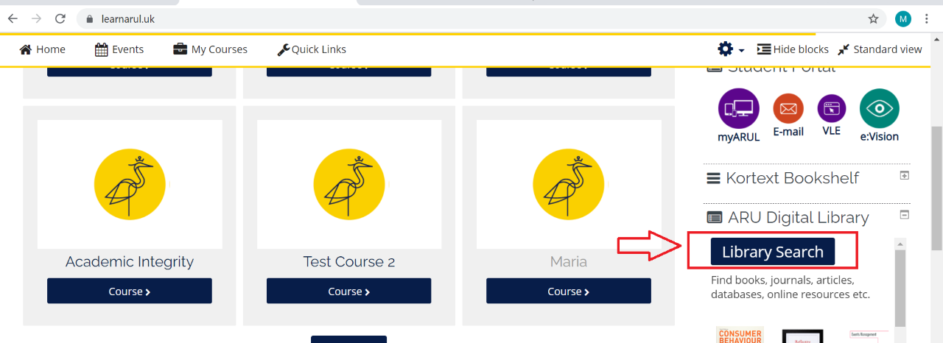
Library Access via the VLE

Slide 19
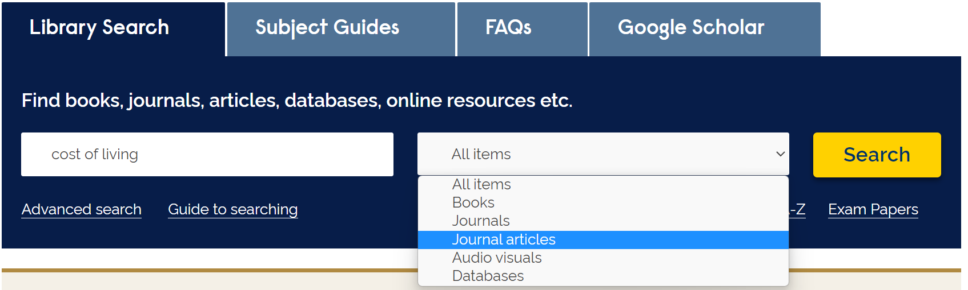
Use your key words and select source
Select the type of source you want from
the drop down menu
Type your key words here

Slide 20
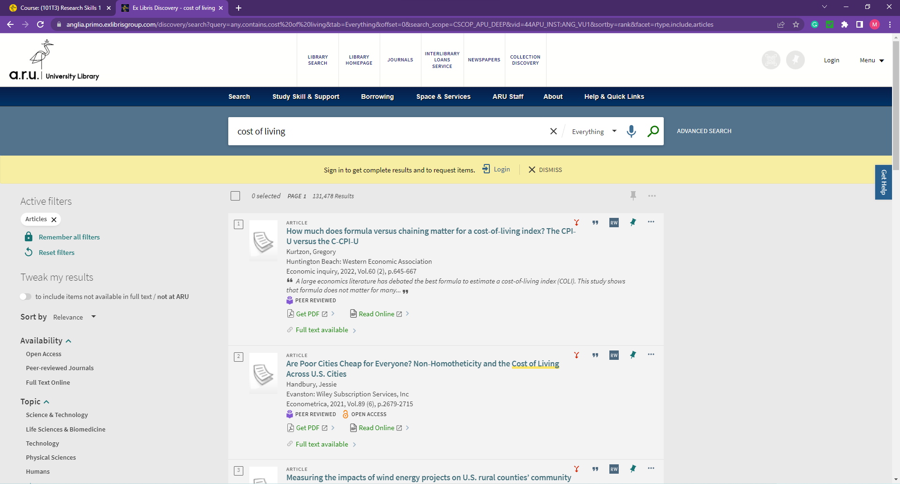
Search results
Click on the links to see the source.

Slide 21
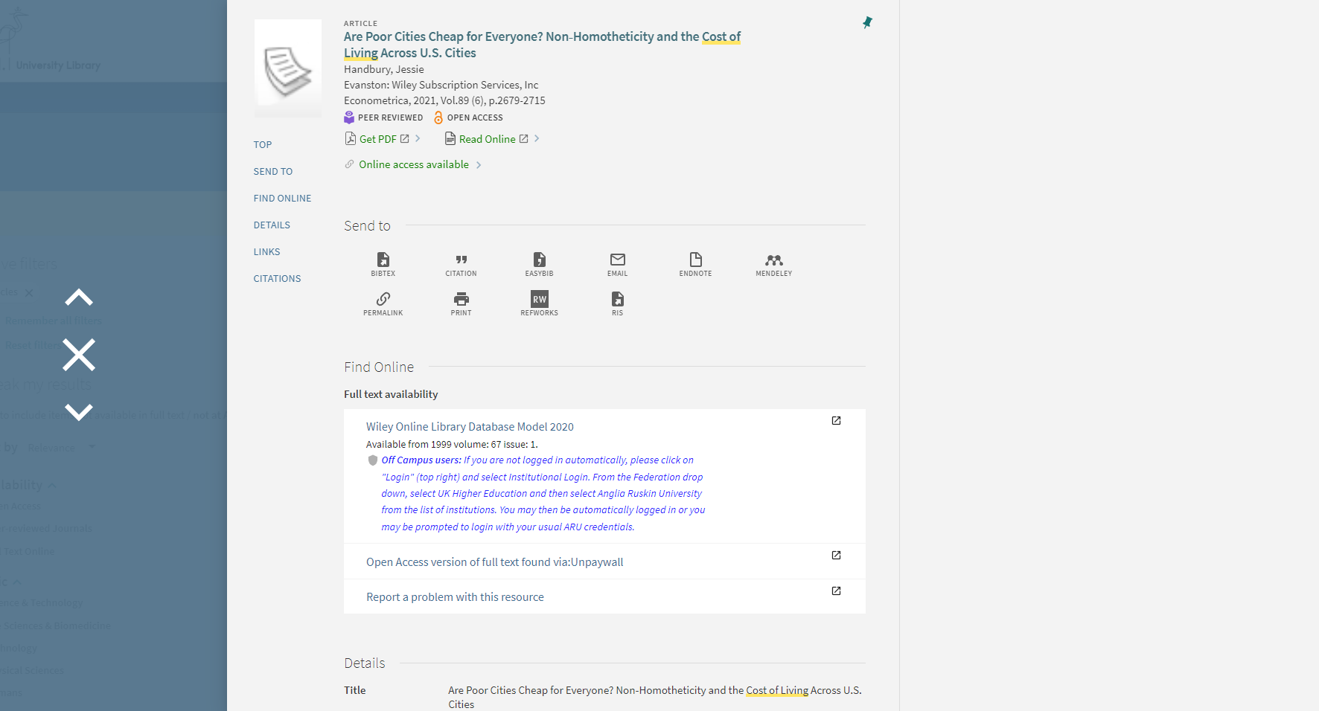
Click on the source
Click on the links to see the source.

Slide 22
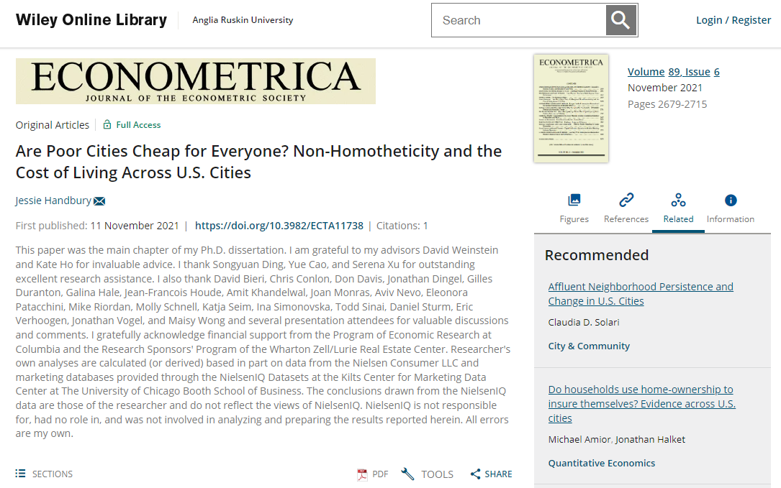
Click ‘Login’ or ‘Login via institution’.

Slide 23

To open a source use your e-vision login. You were sent this in an email.
evisionusername@
student.aru.ac.uk
Your password is your date of birth unless you have reset it.

Slide 24
Troubleshooting
When trying to access the materials, some of the links may not work, so just click on the next link.
Make sure you have not confused ‘journal’ and ‘journal article’ when you select your search item.
You should not be paying any money for access to sources.
If you cannot access a source, move on to the next one, there are plenty. The search in the screenshot previous had 293,621 possible sources.
When you find a good source, bookmark it. It can be very difficult to find sources again.
If a database asks you to login in as an institution, search for Anglia Ruskin University in the dropdown menu.
If you are having trouble, ask Maria in the library; she is awesome.

Slide 25
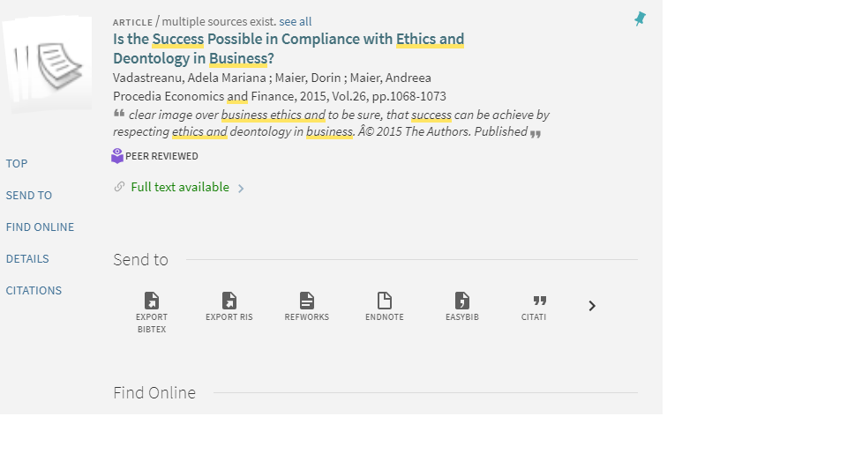
Bookmarking on your device
You can save articles
by clicking
on the pin icon

Slide 26
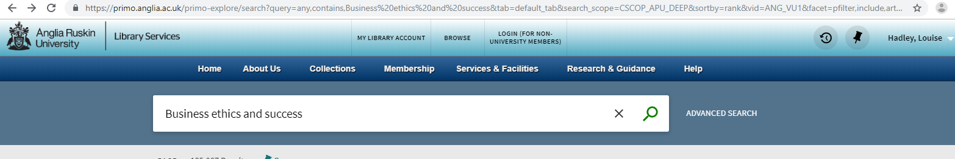
Seeing your pins
Click here to see
your pins

Slide 27
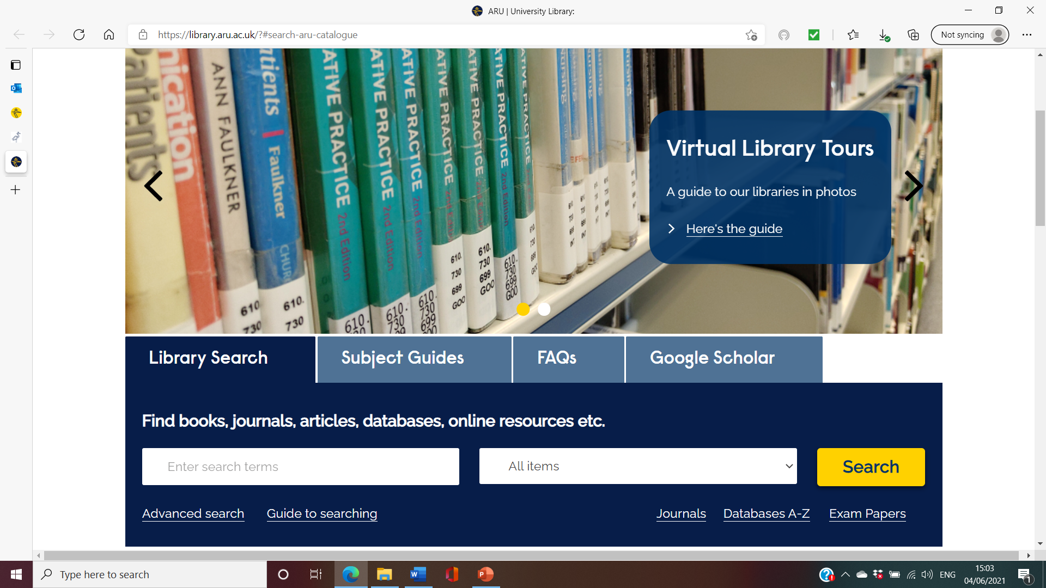
Google Scholar
Google Scholar is database of studies and articles. You have to pay for many of these, but not if you link Google Scholar to your library account.
You can also access Google Scholar from the digital library
You can also access Google Scholar by typing in ‘Google Scholar’ to any search engine

Slide 28
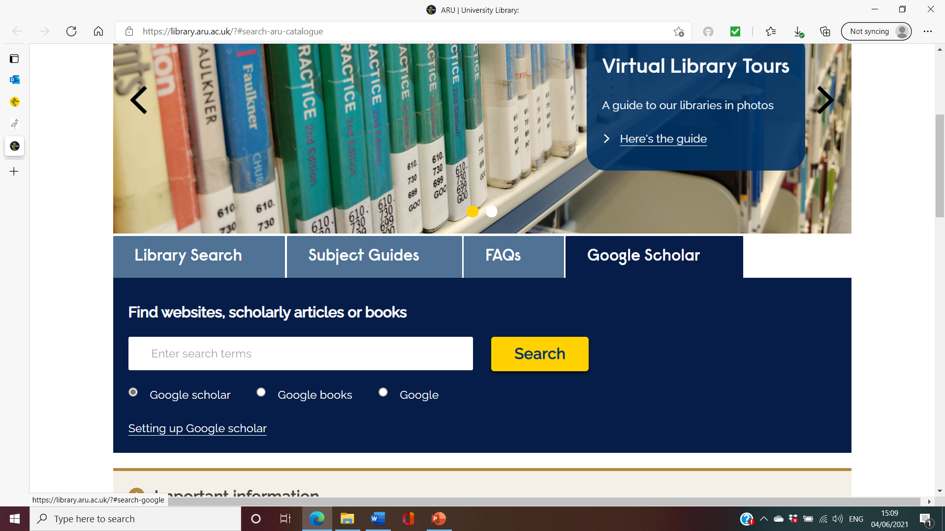
Set up Google Scholar
Click on the Google Scholar tab
Click on Setting up Google scholar – you only need to do this once. It means you won’t have to pay to open any databases.

Slide 29
Activity 3: Your turn
Try logging on to the digital library
See if you can open the following article:
Advantages, Limitations and Recommendations for online learning during COVID-19 pandemic era
Khadijah Mukhtar, Kainat Javed, Mahwish Arooj and Ahsan Sethi

Slide 30
Into Action
Today’s Topic: Online Learning
Discuss the advantages and disadvantages of online learning.
In groups, discuss what you know about this topic. Use the questions on the handout to help you.
You have 10 minutes to discuss and to be ready to share your ideas with the class.

Slide 31
Activity 4: Discussion Questions
In your groups, use these questions to help guide the discussion of today’s topic.
You should all make notes on your answer to question 6, you will need this for the next activity.
Please ensure everyone gets a chance to speak.
What do you know about this topic?
Have you seen anything about it in the news?
Do you, or anyone you know, have experience of this topic?
How do you think this topic might affect you?
Who do you think this might affect?
What are some of the advantages/disadvantages of this topic?

Slide 32

Share your answers with the class

Slide 33
Activity 5a - Analysing the question
Discuss the advantages and disadvantages of online learning.
1. Underline the key words in the question.
2. What is the question asking you to do?

Slide 34
Activity 5a - Analysing the question- Answers
Discuss the advantages and disadvantages of online learning.
2. Discuss – write about a topic taking into account different ideas/issues

Slide 35
Activity 5b – Search Terms
3. Which words would you use as search terms?
4. Do you know any synonyms (words that have the same meaning) for the search terms you have underlined? This will help you to widen your search.

Slide 36
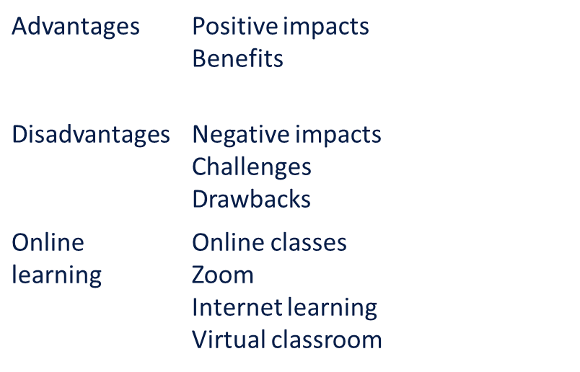
Activity 5b – Search Terms- Answers
3. Advantages/ disadvantages / online learning4.
4.

Slide 37
Activity 6: Online Search
You now have 15 minutes to find ONE source that you could use in your imagined essay.
You can use the online library or Google Scholar.
It can be to either support an advantage or a disadvantage or it may be to give some general information about online learning.
Find either a reliable or an academic source.
Use your search terms.
Use the 7 questions used in Activity 1 to help you to evaluate your source plus one extra question about the relevancy of the source to the topic.

Slide 38
Activity 7: Preparing for feedback
In your groups compare your sources.
Choose ONE source to offer to the class.
Be prepared to evaluate the source in front of the class by going through the 7 questions.

Slide 39
Activity 8: Feedback
Listen to your classmates evaluate their sources, do you think the sources they found were reliable, academic or unreliable?
If you think they were unreliable, give your reasons.

Slide 40
Extension Activity
Pass all the links to your sources to another group.
Let them evaluate the sources to see if they agree that this is a good source to use.

Slide 41
Activity 9: Reflections on today’s learning outcomes
In groups, reflect on your understanding of today’s learning outcomes.
On your own, take the self-assessment again.
To understand the difference between a reliable source and an academic source.
To be able to evaluate a source.
To be able to use the digital library.
To be able to search for a source on a given topic and decide if it is unreliable, reliable or academic.

Slide 42
Self – Assessment Follow up
If you have ticked ‘I don’t know what this means’ or ‘I know what this means, but I can’t do it’, you must take action:
Review the class materials.
Make sure you have answered all of the questions on the class handout – check your answers against the lecturers’ version.
Be sure to take the quiz.
Do the suggested reading.
If you are having IT issues or cannot log on to the library, contact Online Support on the VLE.
Please be aware that these skills will be practised throughout the course, so if you are not 100% confident, don’t worry, you will have plenty of chances to practise. If you do feel confident, that’s great – by the end of the course you will be an expert!

Slide 43
Q&A
Now is your opportunity to ask any questions.

Slide 44
Activity 9: Quiz
Take the quiz on the VLE about reliable and academic sources

Slide 45
Homework
Reading: How do you decide what to read? Godfrey p.8-17
Resolve any outstanding IT issues
Link Google Scholar to your library account.
Finish the quiz

